Slide 1
Lecture
Excel
Working with Text and Data

Slide 2
Manipulating Text
Change upper/lower case
Combine cells with static text
Combine multiple text cells
Portion of text cells
Combine text with numbers

Slide 3
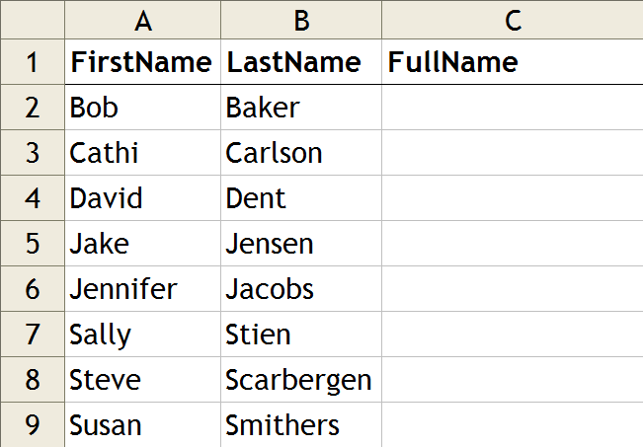
Changing Case
= UPPER(A2)
BOB
= LOWER(A3)
cathi
= PROPER(A4)
David

Slide 4
Combining Cells w/ Static Text
= “Hello ” & A2
Hello Bob
= “Mr. ” & B3
Mr. Carlson
= “Hello, ” & A4 & “!”
Hello, David!

Slide 5
Combining Multiple Text Cells
= A2 & “ ” & B2
Bob Baker
= B3 & “, ” & A3
Carlson, Cathi
= “Mr. ” & A4 & “ ” & B4
Mr. David Dent

Slide 6
Portions of Text Cells
= LEFT(A2,1) & “. ” & B2
B. Baker
= RIGHT(B5,4)
nsen
Useful when combined with other functions like FIND.
= MID(B8,3,4)
arbe

Slide 7
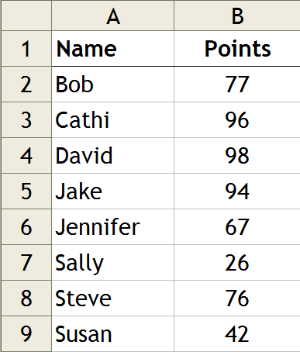
Combining Text with Numbers
= A2 & “: ” & B2
Bob: 77
= A3 & “scored ” & B3
Cathi scored 96
= IF(B5>90,“Great job, ”&A5,“Bummer.”)
Great job, Jake
= IF(B8>90,“Great job, ”&A8,“Bummer.”)
Bummer.

Slide 8
Additional Text/Data Functions
Spell Check
Filter
  Data | Filter | AutoFilter
Find/Replace
Sort
  Data | Sort
    (Expand Selection if prompted)
Paste Special

